Slide 1
Input Output Linearization for Guidance
Alexander Dorsey, Ankit Goel
Department of Mechanical Engineering University of Maryland, Baltimore County
Notes:
Today I will present an input–output feedback linearization based guidance law for guaranteed interception in a pursuer–evader engagement.
I will show two formulations: one based on regulating range, and one based on regulating the line-of-sight angular rate. I will also show why each formulation breaks in practice, and the proposed fixes to those failures.

Slide 2
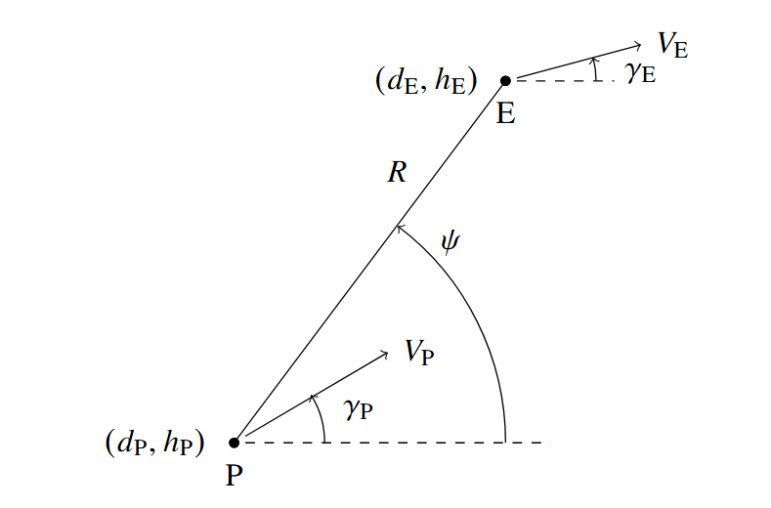
Problem Statement
Proportional Guidance is simple and tested, but does not guarantee interception under nonlinear dynamics
However, Input-Output Linearization offers a way to guarantee interception by enforcing closed loop error dynamics. Two methods are proposed:
Regulating Range
Regulating Angular Rate of the line-of-sight vector.
Notes:
Missile guidance is fundamentally nonlinear.
Many operational systems rely on proportional guidance or an offshoot of Proportional Guidance because it is simple and robust. However, PG is derived under restrictive assumptions such as constant speed for the pursuer and evader. Once those assumptions are violated, interception is not guaranteed.
The question this work asks is: Can we design a real-time, nonlinear guidance law that guarantees interception theoretically with fewer assumptions?
To do this, I use input output linearization. If we cancel the non-linear dynamics of the closed-loop output dynamics, interception becomes a stability problem.

Slide 3
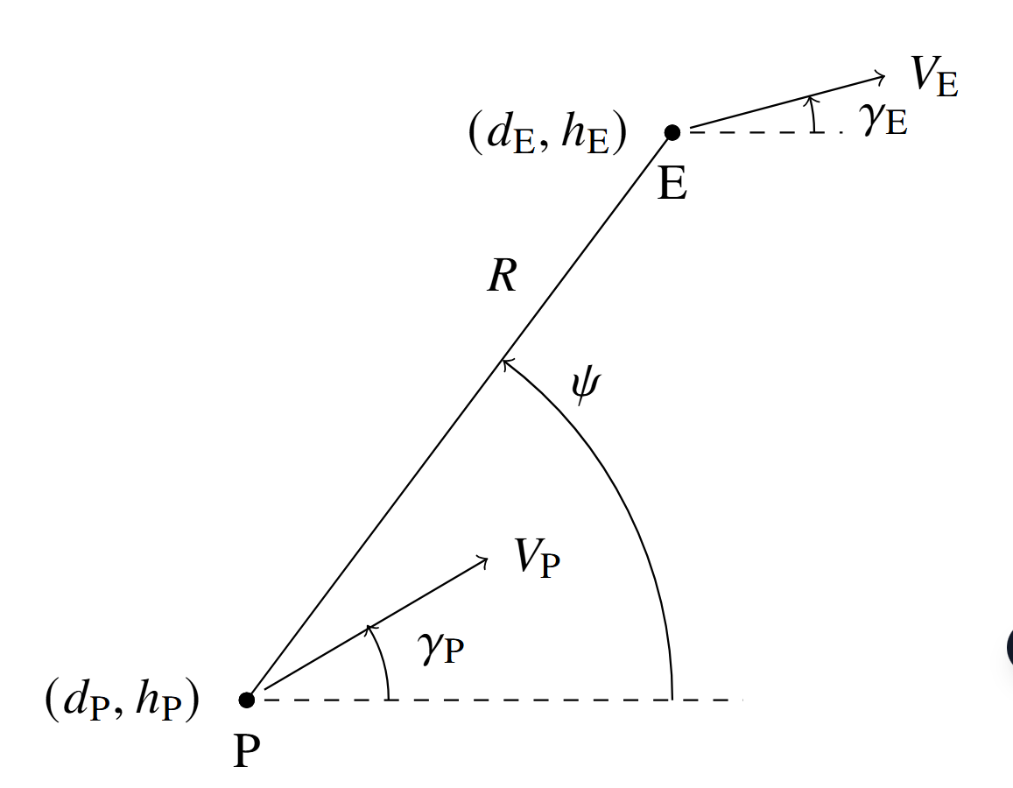
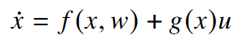
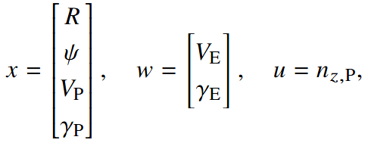
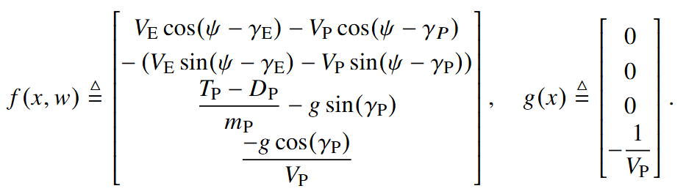
Dynamics
IOL Guidance requires the affine structure:
Where the state vector is
Thus, from the point mass dynamics:
Notes:
We consider planar point-mass dynamics for both the pursuer and the evader.
The state includes:
Range R
Line-of-sight angle ψ
Pursuer speed Vₚ
Pursuer flight-path angle γₚ
The evader dynamics are treated as an exogenous input.
The key equations are the relative kinematics for Ṙ and ψ̇, coupled with the pursuer’s normal acceleration command n_z as the control input.
The system can be written in affine nonlinear form: ẋ = f(x,w) + g(x)u
This affine structure is what enables input–output linearization.
Note that the required information for the IOL guidance are the states and variables within f(x,w) and g(x). So it is required to know the velocity of the evader, net acceleration of the pursuer, and azimuth angle in the 2D case.

Slide 4
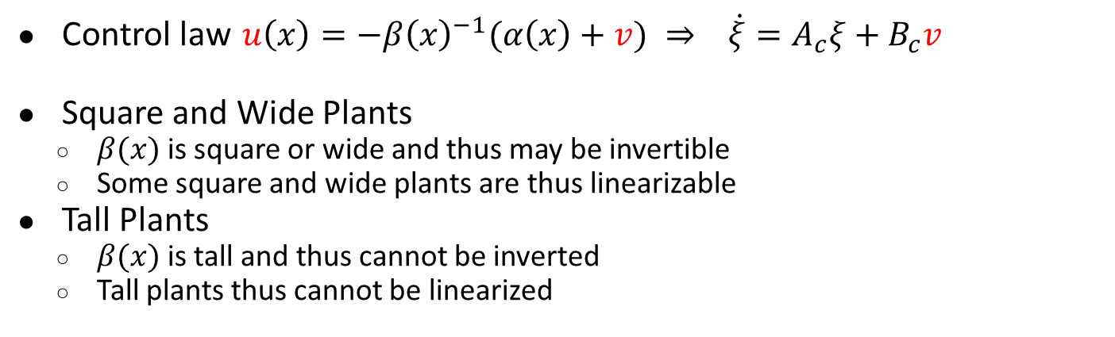
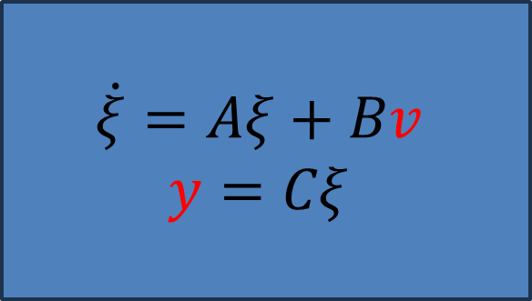
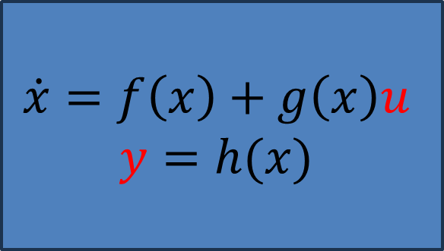
MIMO Input-Output Feedback Linearization
$$\dot{x}=f\left(x\right)+g\left(x\right)u$$
$$y=h(x)$$
$$\dot{ξ}=Aξ+Bv$$
$$y=Cξ$$
Linearization
Control law $u\left(x\right)=−β{\left(x\right)}^{−1}(α\left(x\right)+v) ⇒ \dot{ξ}=A_{c}ξ+B_{c}v$
Square and Wide Plants
$β(x)$ is square or wide and thus may be invertible
Some square and wide plants are thus linearizable
Tall Plants
$β(x)$ is tall and thus cannot be inverted
Tall plants thus cannot be linearized
Notes:
The reason why this technique is called feedback linearization is due to the fact that the nonlinear transformation is performed by feedback. This implies that the controller carries information of the system (alpha and beta here). After linearizing the system, if zero dynamics does not exist or if it is stable, a simple linear controller can be applied (v here) to stabilize the system. An inversion needs to be performed in beta as shown here. This is possible if the system is square or wide (equal number of inputs and outputs or more inputs than outputs), which implies that some of the square and wide plants are fully linearizable. Nevertheless, when plants are tall (More outputs than inputs) this inversion is impossible.

Slide 5
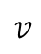
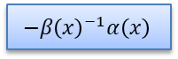
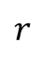
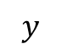
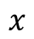
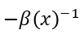
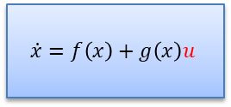
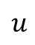
MIMO Input-Output Linearization
Linearized System
Linear Controller
$$v$$
$$u$$
$$\dot{x}=f\left(x\right)+g\left(x\right)u$$
$$r$$
$$−β{\left(x\right)}^{−1}$$
$$y$$
$$x$$
$$−β{\left(x\right)}^{−1}α\left(x\right)$$
Notes:
Graphically, here in Orange we have the linearized system, performed by the feedback term beta inverse multiplied by Alpha. After having a linearized system, if there is no zero dynamics or if the zero dynamics is stable, a linear controller can be applied to stabilize the system.

Slide 6
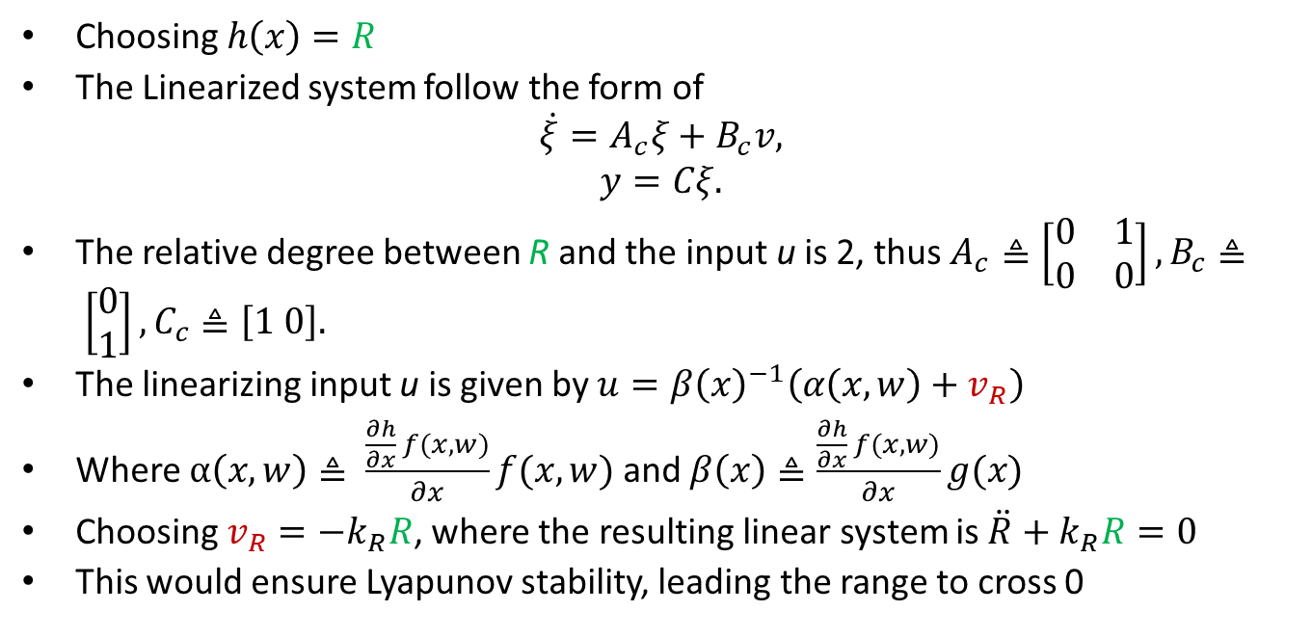
IOL Formulation - Range
Choosing $h\left(x\right)=R$
The Linearized system follow the form of
$$\dot{ξ}=A_{c}ξ+B_{c}v,$$
$$y=Cξ.$$
The relative degree between R and the input u is 2, thus $A_{c}≜\left[\begin{matrix}0 & 1 \\ 0 & 0\end{matrix}\right], B_{c}≜ \left[\begin{aligned}0 \\ 1\end{aligned}\right], C_{c}≜\left[1 0\right].$
The linearizing input u is given by $u=β{\left(x\right)}^{−1}\left(α\left(x,w\right)+v_{R}\right)$
Where $α\left(x,w\right)≜ \frac{\frac{∂h}{∂x} f(x,w)}{∂x}f(x,w)$ and $β\left(x\right)≜\frac{\frac{∂h}{∂x} f(x,w)}{∂x}g(x)$
Choosing $v_{R}=−k_{R}R$, where the resulting linear system is $\ddot{R}+k_{R}R=0$
This would ensure Lyapunov stability, leading the range to cross 0
Notes:
First, we choose the output as range: y = R
The relative degree is two.
After differentiation, we obtain a second-order linear system: R̈ = v
We choose: v = −k_R R
This yields: R̈ + k_R R = 0
This system is Lyapunov stable, not asymptotically stable. But that is sufficient. Interception only requires R to cross zero once.
At first glance, this guarantees interception.
However, the decoupling term β(x) contains sin(ψ − γₚ).
When ψ − γₚ approaches 0 or π, corresponding to tail-chase or head-on geometries, β(x) goes to zero.
This causes the control command to blow up.

Slide 7
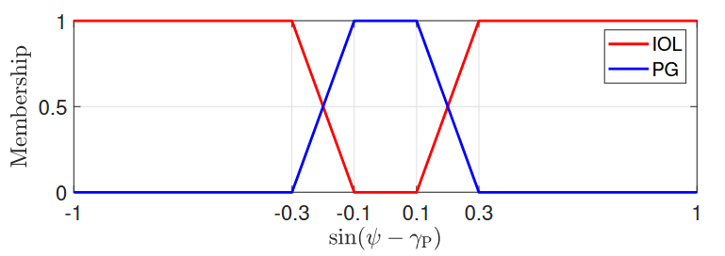
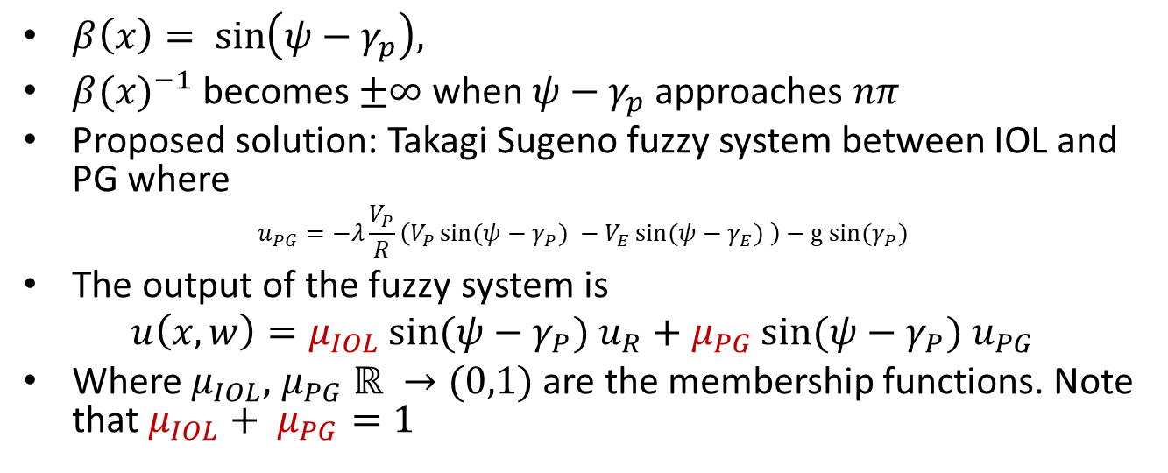
IOL Control Signal Corrections
Range
$β\left(x\right)= \sin\left(ψ−γ_{p}\right),$
${β(x)}^{−1}$ becomes $±∞$ when $ψ−γ_{p}$ approaches $nπ$
Proposed solution: Takagi Sugeno fuzzy system between IOL and PG where
$$u_{PG}=−λ\frac{V_{P}}{R}\left(V_{P}\sin{(ψ−γ_{P}}) −V_{E}\sin{(ψ−γ_{E}}) \right)−g sin(γ_{P})$$
The output of the fuzzy system is
$$u\left(x,w\right)=μ_{IOL}\sin{(ψ−γ_{P}}) u_{R}+μ_{PG}\sin{(ψ−γ_{P}}) u_{PG}$$
Where $μ_{IOL},$ $μ_{PG} ℝ →(0,1)$ are the membership functions. Note that $μ_{IOL}+ μ_{PG}=1$
Notes:
This singularity makes pure range-based IOL unusable in practice.
To fix this, we introduce a Takagi–Sugeno fuzzy blending scheme.
When sin(ψ − γₚ) is away from zero, we use the IOL control law.
When it approaches zero, we smoothly transition to classical proportional guidance.
This guarantees bounded control effort

Slide 8
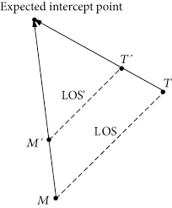
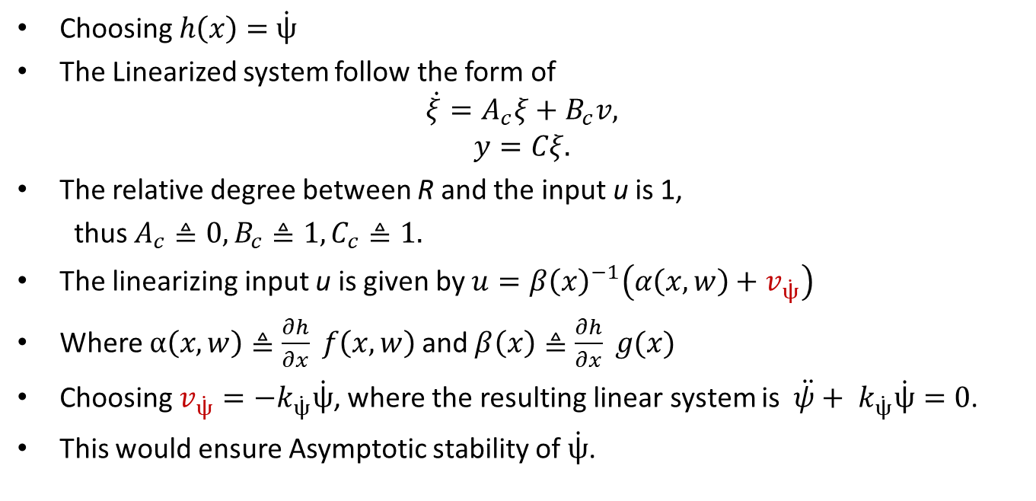
IOL Formulation – Angular Rate
Choosing $h\left(x\right)=$ $\dot{ψ}$
The Linearized system follow the form of
$$\dot{ξ}=A_{c}ξ+B_{c}v,$$
$$y=Cξ.$$
The relative degree between R and the input u is 1,
thus $A_{c}≜0, B_{c}≜1, C_{c}≜1.$
The linearizing input u is given by $u=β{\left(x\right)}^{−1}\left(α\left(x,w\right)+v_{\dot{ψ}}\right)$
Where $α\left(x,w\right)≜\frac{∂h}{∂x} f\left(x,w\right)$and $β\left(x\right)≜\frac{∂h}{∂x} g(x)$
Choosing $v_{\dot{ψ}}=−k_{\dot{ψ}}\dot{ψ}$, where the resulting linear system is ${\ddot{ψ}+ k}_{\dot{ψ}}\dot{ψ}=0$.
This would ensure Asymptotic stability of $\dot{ψ}$.
Notes:
Next, we choose the output as the LOS rate: y = ψ̇
This output has relative degree one.
The resulting closed-loop dynamics are: ψ̈ + k ψ̇ = 0
This is asymptotically stable.
Unlike the range-based formulation, the decoupling term does not introduce singularities in common engagement geometries.
However, this formulation introduces a different failure mode.
It is possible for ψ̇ to converge to zero while the range diverges to infinity.
Thus, The pursuer flies a parallel trajectory, where the line of sight rate is 0, but interception never occurs.

Slide 9
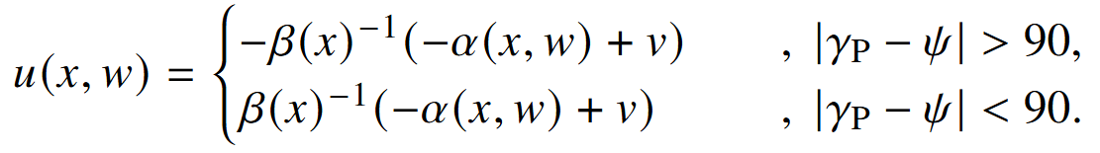
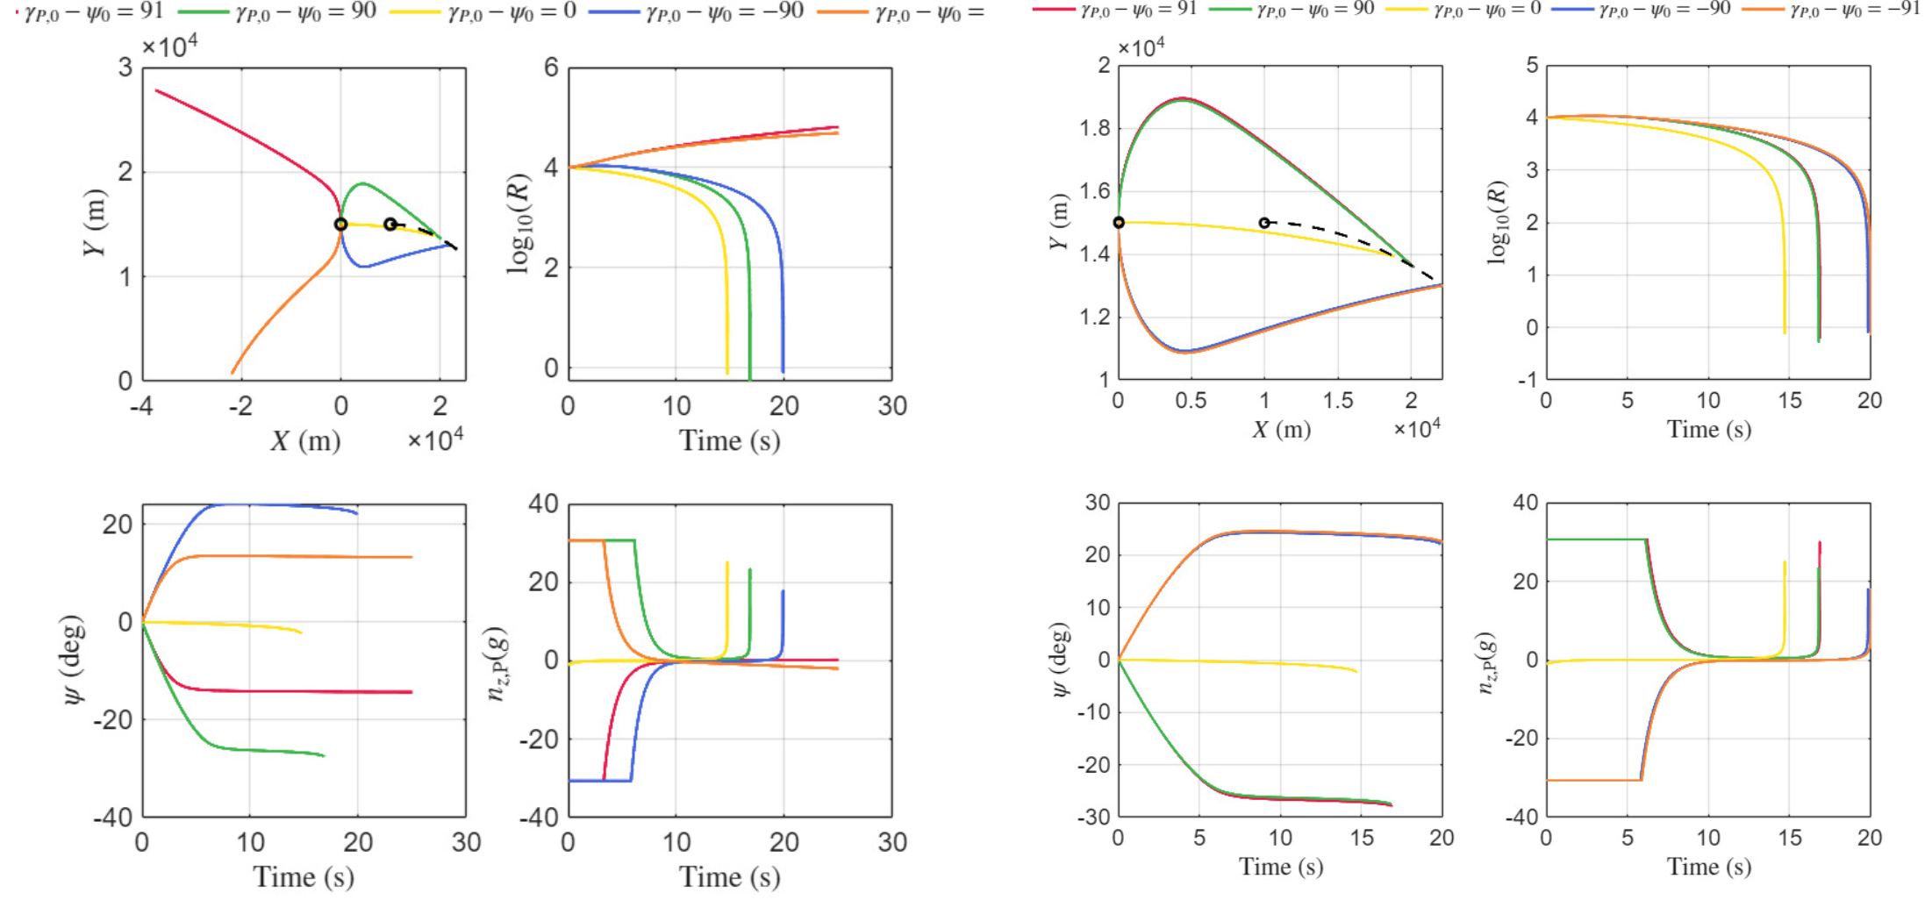
IOL Control Signal Corrections
Angle: Bistable solution fix:
Notes:
This divergence occurs when the pursuer’s velocity vector points away from the evader.
To correct this, we introduce a simple sign-based logic.
If |γₚ − ψ| is greater than 90 degrees, we flip the sign of the control input.
This forces the pursuer to reorient toward the evader before continuing LOS regulation.
This correction is minimal, easy to implement, and restores guaranteed interception.

Slide 10
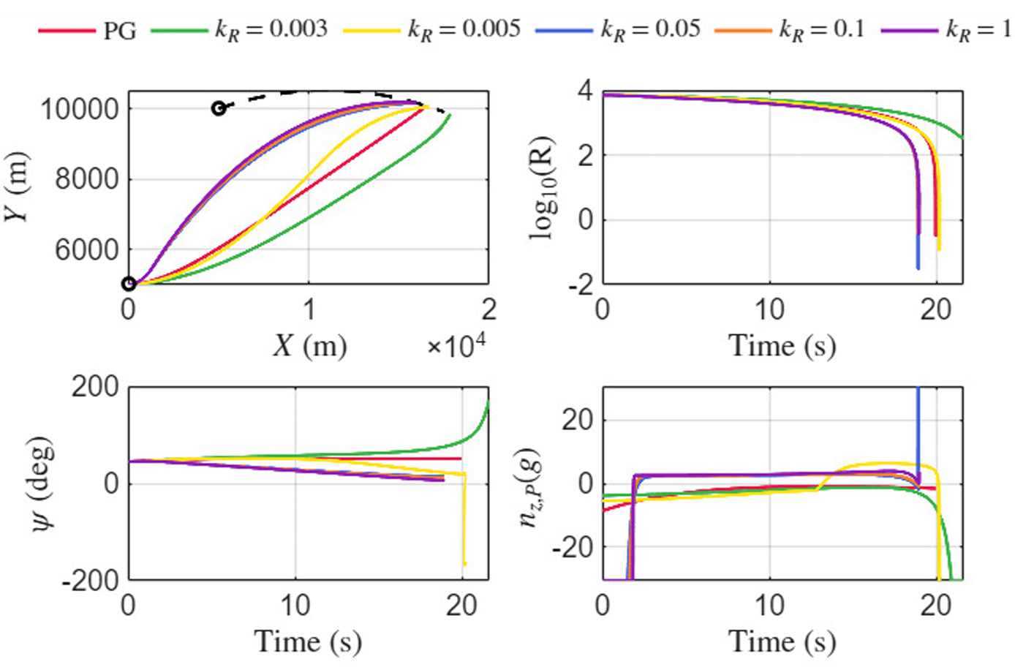
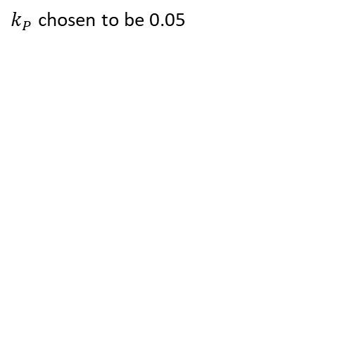
Tuning Range Gain
Simulation Results
$k_{P}$ chosen to be 0.05

Slide 11
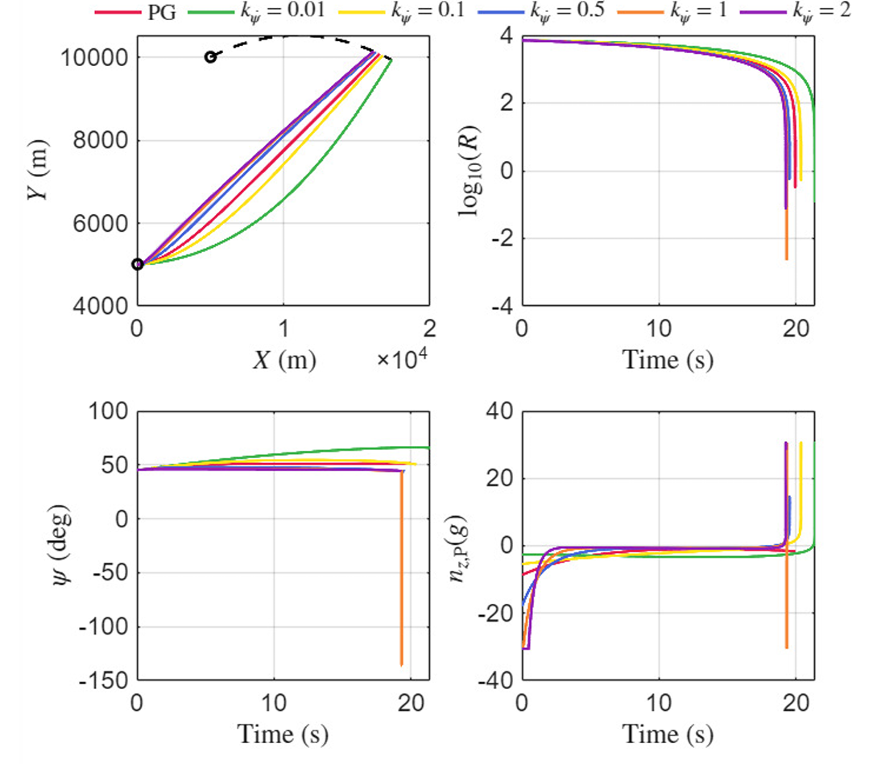
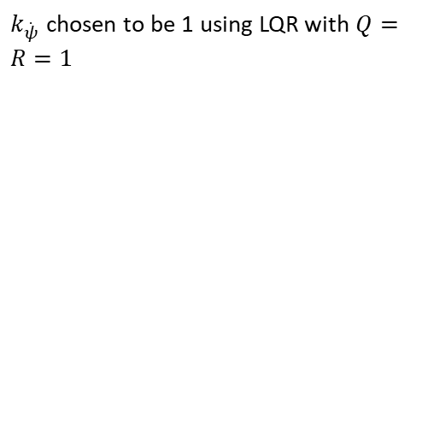
Tuning Angle Gain
Simulation Results
$k_{\dot{ψ}}$ chosen to be 1 using LQR with $Q=R=1$

Slide 12
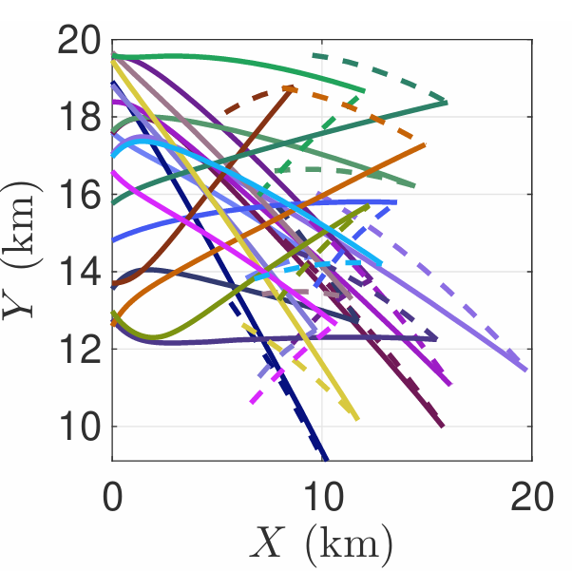
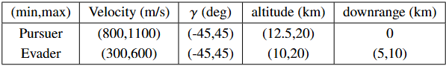
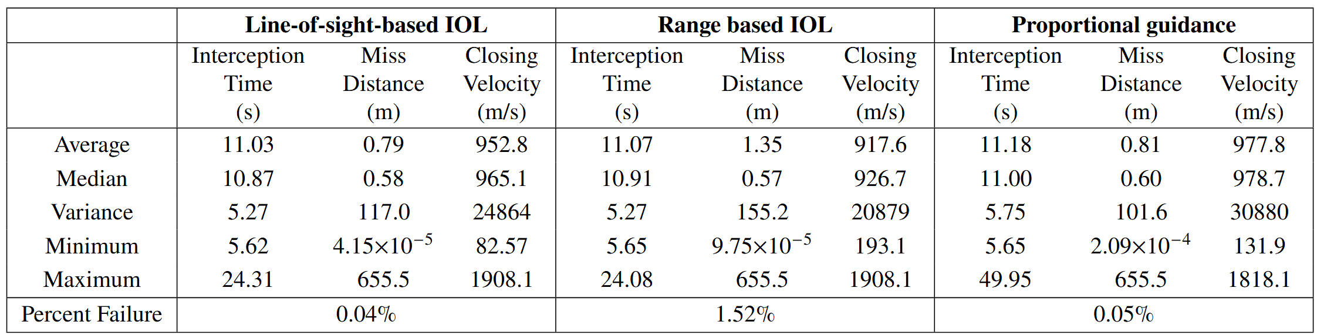
Simulation Results
Monte-Carlo Simulation: Rear Aspect Engagement
Notes:
We evaluate performance using Monte Carlo simulations with point-mass dynamics.
Three guidance laws are compared:
Proportional Guidance
Range-based IOL
LOS-based IOL
Scenarios include:
Rear-aspect engagements
Front-aspect engagements
Front-aspect with maneuvering evaders
10,000 randomized trials are run per scenario.
An intercept is successful if the miss distance is less than 10 meters.
In rear-aspect engagements, all three guidance laws perform well.
LOS-based IOL achieves the lowest mean miss distance and the lowest failure rate.
Range-based IOL shows slightly worse robustness, with a higher sensitivity to initial geometry.
Proportional guidance performs comparably but with slightly longer interception times.

Slide 13
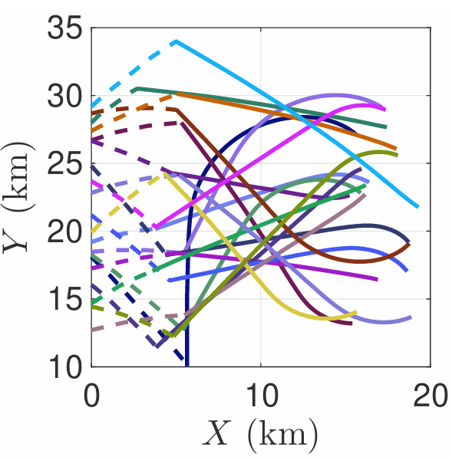
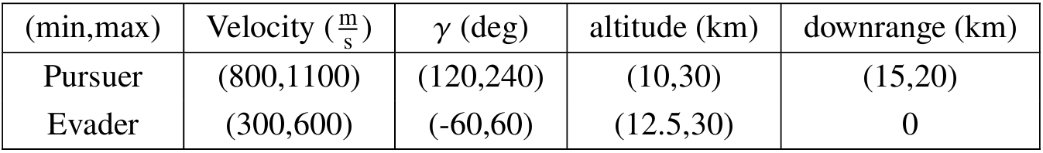
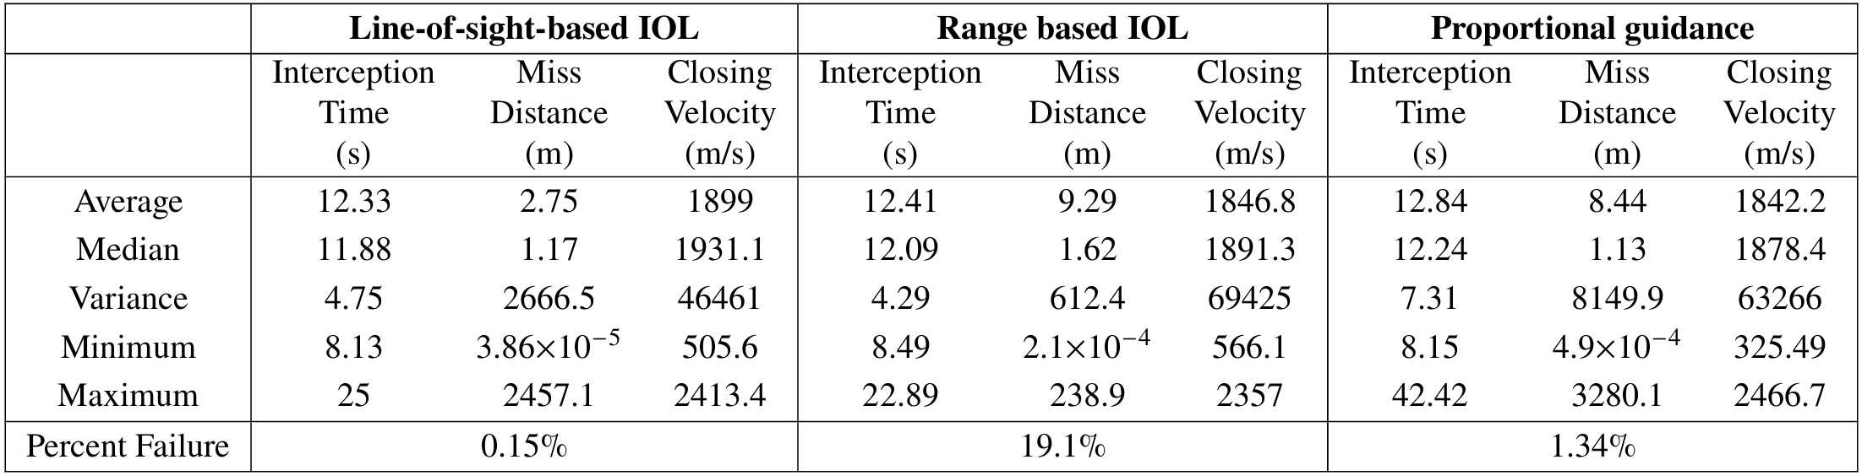
Simulation Results
Monte-Carlo Simulation: Front Aspect Engagement
Notes:
In front-aspect engagements, the differences are significant.
LOS-based IOL achieves:
The lowest miss distance
The lowest failure rate
Range-based IOL performs poorly, with failure rates exceeding 19 percent.
Proportional guidance performs better than range-based IOL, but worse than LOS-based IOL.
This shows that the Range based IOL does not perform well and the line of sight based IOL performs with a lower failure rate than PG

Slide 14
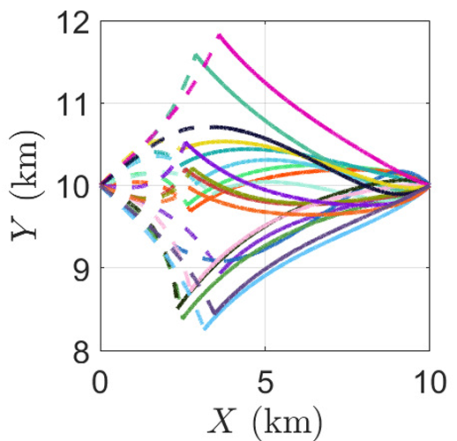
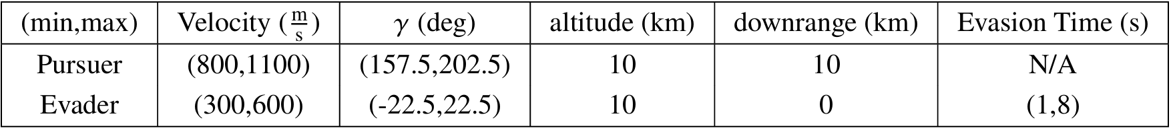
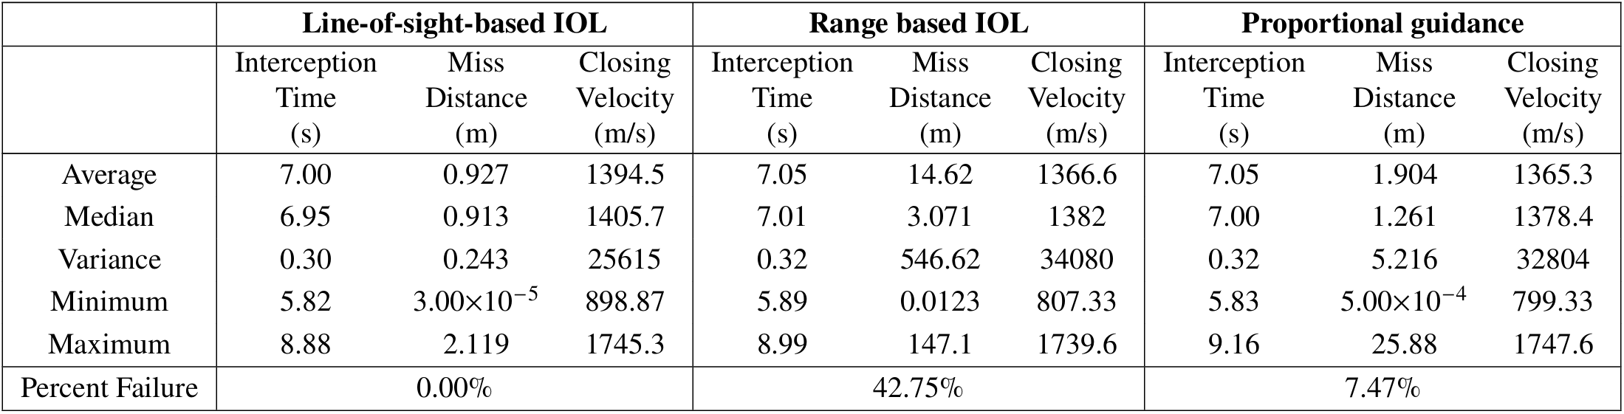
Simulation Results
Monte-Carlo Simulation: Front Aspect Evading Engagement
Notes:
With a maneuvering evader, meaning that at a random time between 1 and 8 seconds, the evader pulls 10 g either positive or negative.
LOS-based IOL achieves zero failures across all trials.
Proportional guidance fails in roughly 7 percent of cases.
Range-based IOL fails in nearly 43 percent of cases.
This clearly demonstrates that the range-based formulation is not suitable for aggressive front-aspect engagements and the LOS IOL’s strength over PG in front aspect engagement scenarios

Slide 15
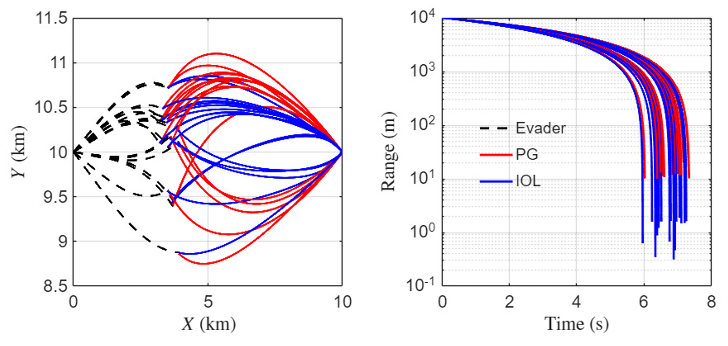
Simulation Results
Monte-Carlo Simulation: Front Aspect Evading Engagement
Notes:
Here is a closer look at some of the failures of PG in the same initial conditions of IOL.
Front the MC Results,
Three main conclusions:
First, input–output linearization can guarantee interception when the output is chosen correctly.
Second, regulating LOS rate is more robust than regulating range for guidance.
Third, small corrective logic can eliminate the wrong solution in a bistable system.
LOS-based IOL consistently outperforms proportional guidance in difficult engagement geometries.

Slide 16
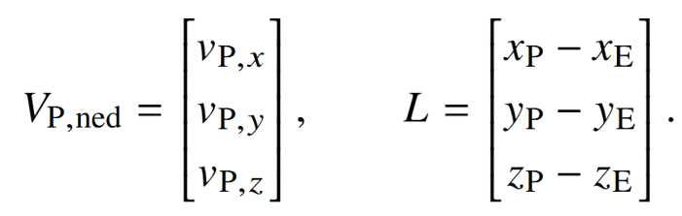
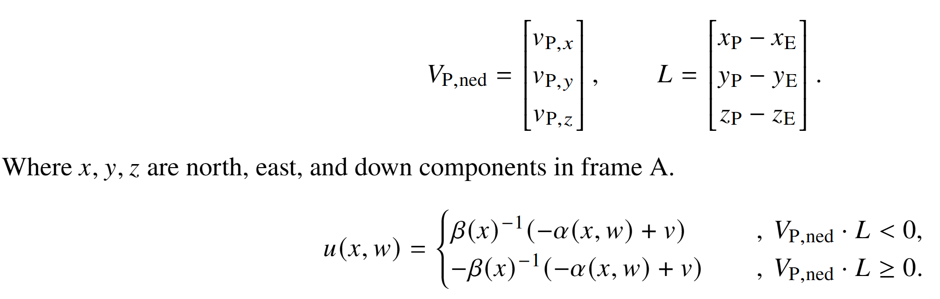
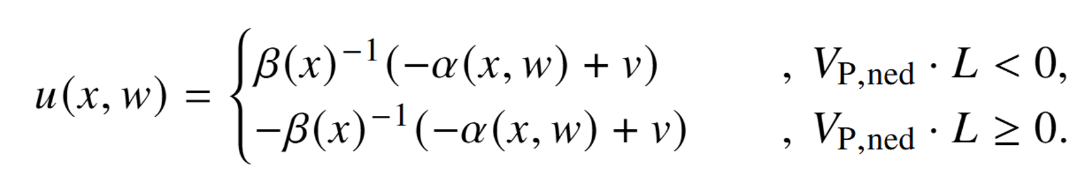
Current Research: 3D extension of IOL
Notes:
Current work extends this framework to three-dimensional engagements.
Ongoing efforts also include:
Sensor noise
Actuator limits

Slide 17
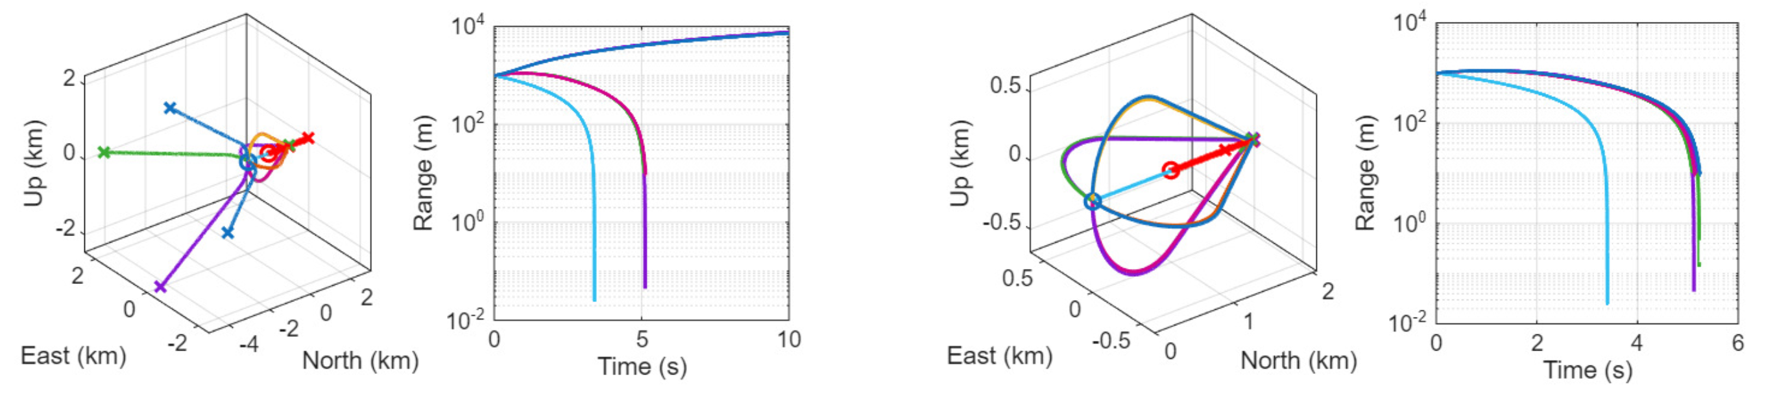

Current Research: 3D extension of IOL
Pre Signal Correction
Post Signal Correction
Matlab IOL Guidance
Formulation Code GITHUB →
Notes:
Current work extends this framework to three-dimensional engagements.
Ongoing efforts also include:
Sensor noise

